Slide 1
Isotopes.au Team Meeting
CSIRO & ANSTO & GA & Lithodat

Slide 2
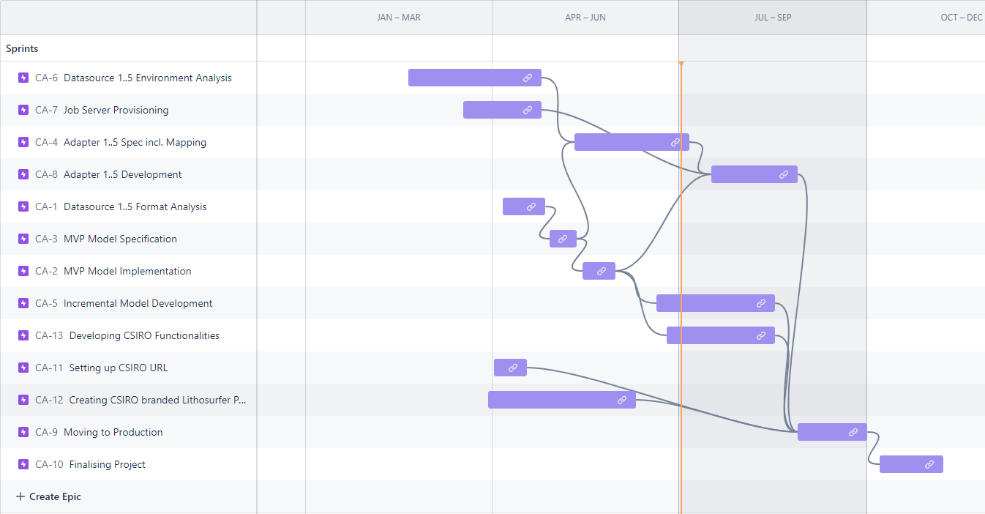
Lithodat internal Timeline
Starting early with LabData Adapter implementation

Slide 3
Lithodat internal Timeline
Test version is ready. Only thing to do for getting feedback is to assign url test.isotopes.au
(Instructions have been sent today.)

Slide 4
Lithodat internal Timeline
After the MVP is accessible to the customer feedback will be collected and worked in.

Slide 5
Lithodat internal Timeline
Also, from a Lithodat point of view the iterative improvement phase can be prolonged by multiple deployments to the production stage.

Slide 6
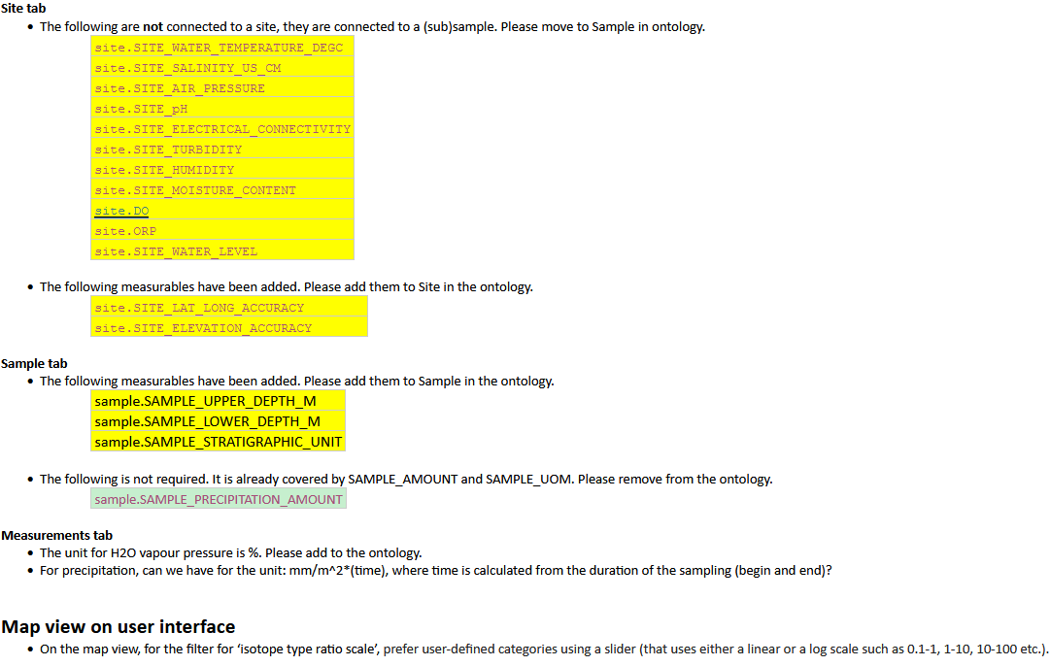
Ontology

Slide 7
Thanks!

Slide 8
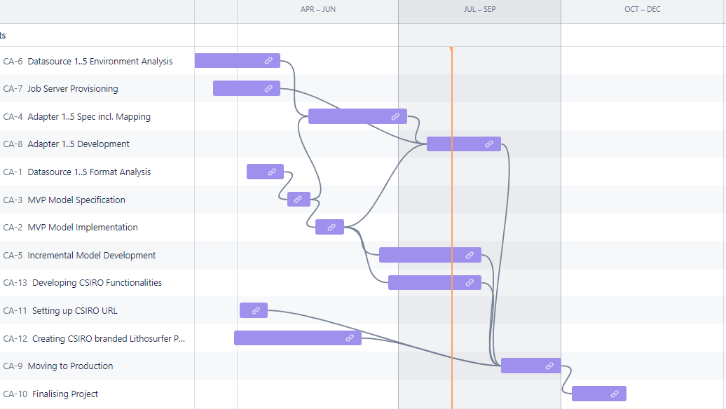
Lithodat internal Timeline

Slide 9
Lithodat internal Timeline
Adapter 3
A. 1
A. 2
A. 4
A. 5
A. 6

Slide 10
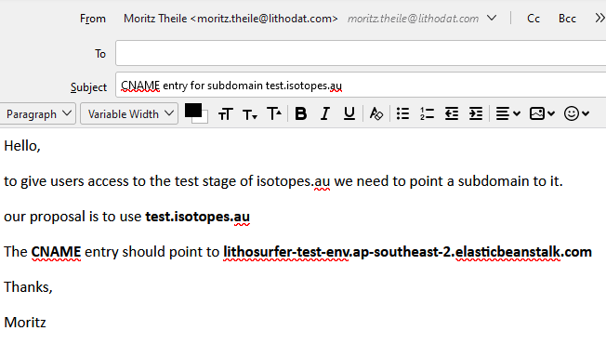
Send Mails with instructions
Who are the recipients?

